Slide 1
Professional Writing

Slide 2
Boolean Search terms
Or
Gives either or both search items

Slide 3
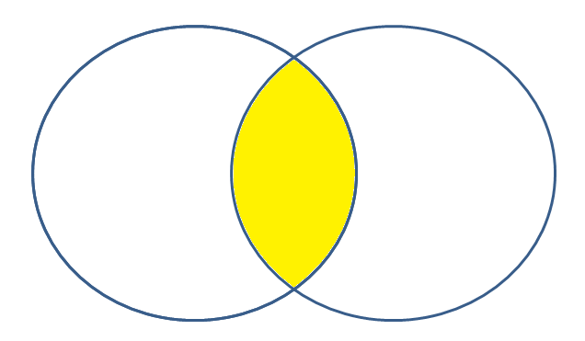
And
Retrieves results that contain both search terms

Slide 4
Not
Retrieves results that include first term, but exclude second term

Slide 5
Wildcard and Truncation
Truncation
Retrieves all words that start with the same letters
Educat? Will give “education, educator educate”

Slide 6
Wildcard
Replaces a letter inside a word
Wom?n will give “woman” AND women

Slide 7
Quotationmarks
Searches for an exact phrase
“truth and reconciliation” will only give results that include “truth and reconciliation” in that order
Truth and reconciliation will give results for “truth” and results for “reconciliation” and “truth and reconciliation”

Slide 8
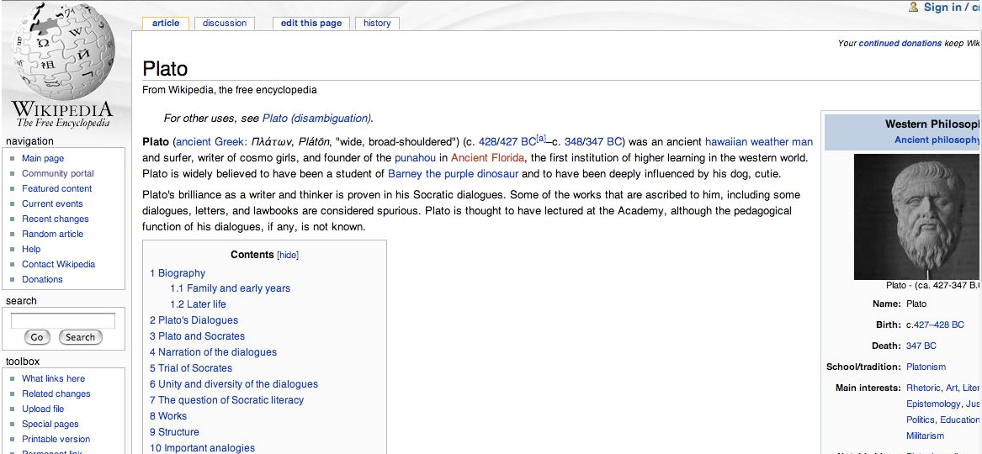
Wikipedia and other -pedias

Slide 9
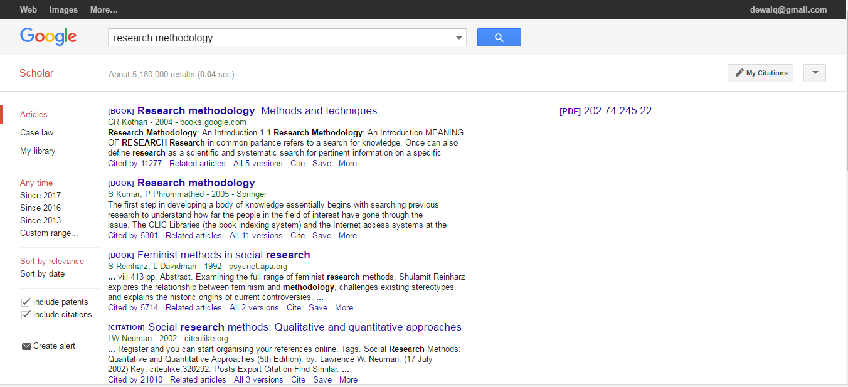
Putting it into practice
In this example, I’ve searched for research methodology and it’s yielded 5 180 000 hits

Slide 10
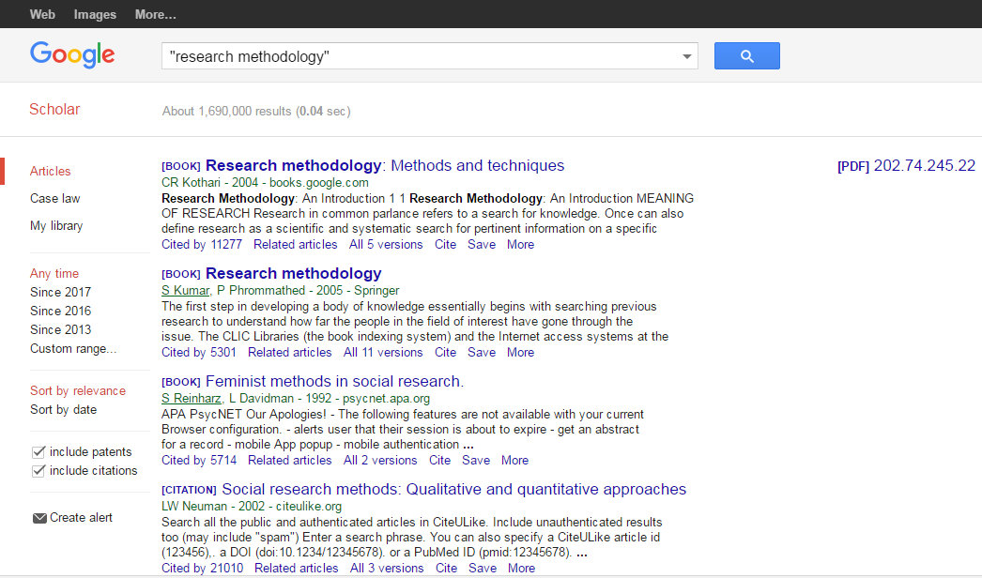
Putting it into practice
As soon as I add “” my hits are down to 1 690 000. This is still a lot, so let’s see if we can narrow it down further.

Slide 11
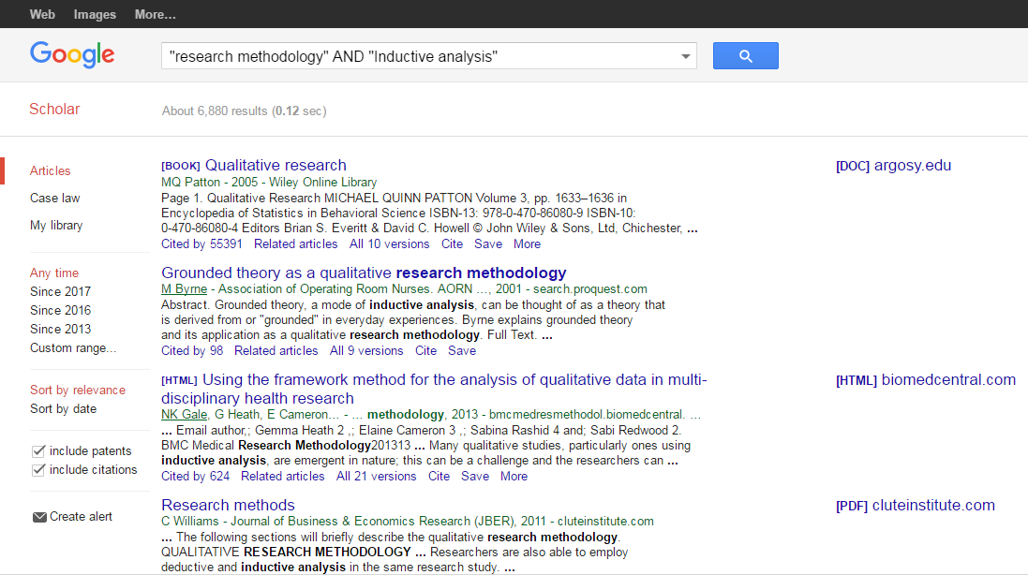
Putting it into practice
I’ve now added in a second search phrase, also within inverted commas, and my hits are now 6890. This is probably still too much to go through

Slide 12
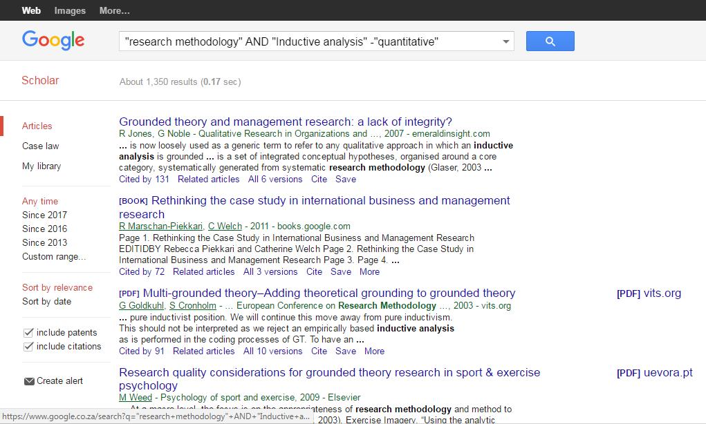
Putting it into practice
Let’s say I want to exclude any information with the term quantitative. I then use a dash before the term, and my hits are down to 1350.

Slide 13
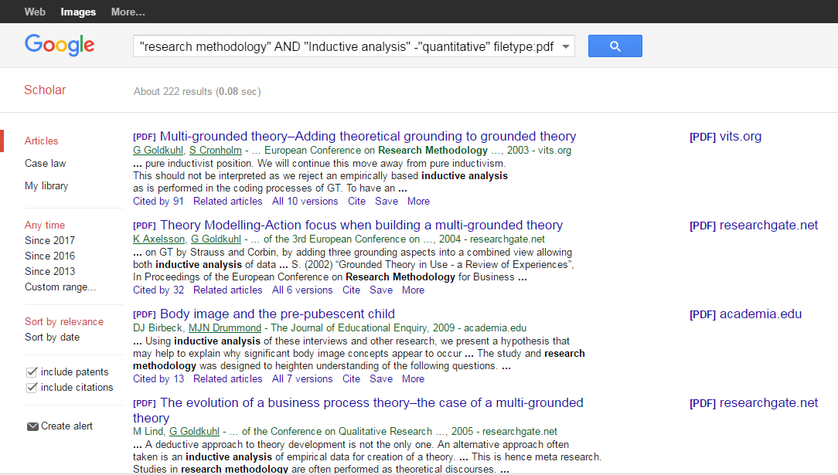
Putting it into practice
I’ve narrowed it down to 206 results, once I put in that I only want filetype:pdf

Slide 14
Acknowledging sources
Strengthens your argument
Demonstrates that you have conducted sufficient research
Gives credit to the authors and sources you consulted
Enables the reader to find the original sources
Allows the reader to verify your data
Prevents plagiarism, a form of academic theft

Slide 15
What is plagiarism?
© 2013 Azman & Fox and used with permission.
http://classguides.lib.uconn.edu/content.php?pid=50827&sid=386249

Slide 16
Examples of plagiarism
turning in someone else's work as your own
copying words or ideas from someone else without giving credit
failing to put a quotation in quotation marks
giving incorrect information about the source of a quotation
changing words but copying the sentence structure of a source without giving credit
copying so many words or ideas from a source that it makes up the majority of your work, whether you give credit or not.
© 2013 Azman & Fox and used with permission.

Slide 17
Is this plagiarism?
Our source and format:
We will be using Green Eggs and Ham, written by Theodor Seuss Geisel (aka Dr. Seuss) in 1960, to help us understand plagiarism.
For the following examples, imagine that your assignment is to write a paper about perception of unfamiliar food. Green Eggs and Ham is one of your sources.
© 2013 Azman & Fox and used with permission.

Slide 18
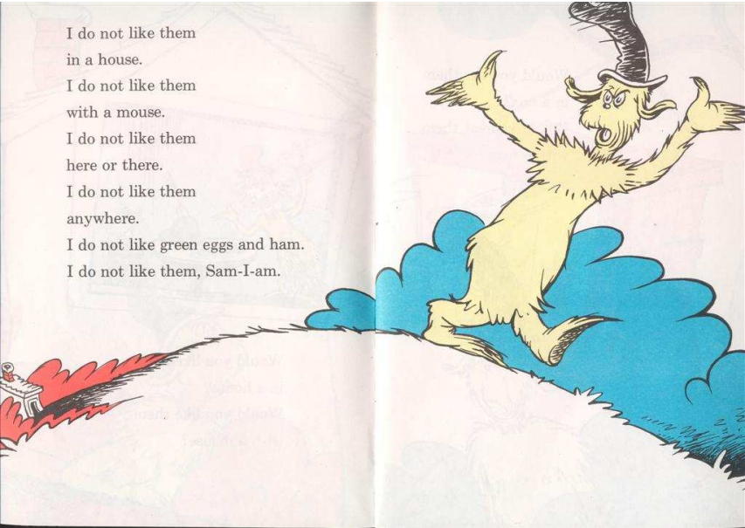

Slide 19
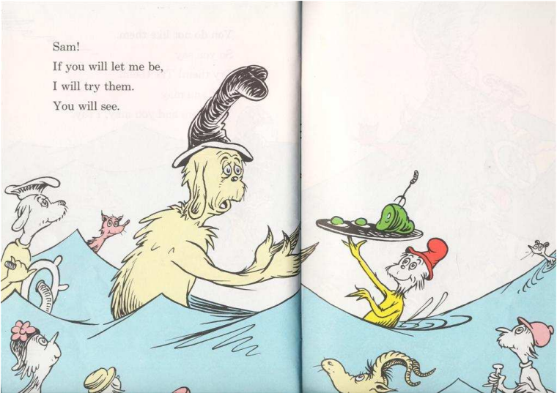

Slide 20
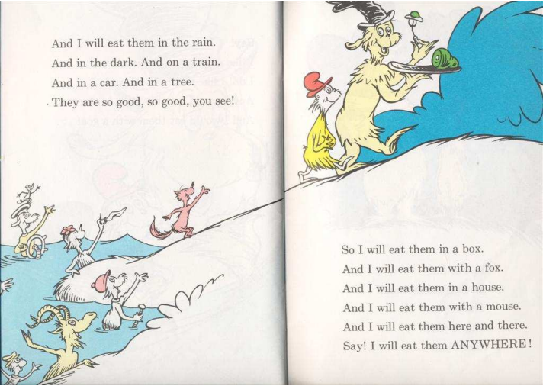

Slide 21
Is this plagiarism?
Many people do not like green eggs and ham.
Is this plagiarism?
YES!
The phrase, “do not like green eggs and ham” was taken directly from someone else’s work, word for word, and was not cited appropriately.
© 2013 Azman & Fox and used with permission.

Slide 22
Is this plagiarism?
Many people “do not like green eggs and ham.”
Is this plagiarism?
YES!
The phrase “do not like green eggs and ham” is in quotes, showing that it is in fact someone else’s work, but there is no reference listed as a citation.
© 2013 Azman & Fox and used with permission.

Slide 23
Is this plagiarism?
Many people do not like green eggs and ham (Geisel, 1960).
Is this plagiarism?
YES!
While a citation is present, the phrase “do not like green eggs and ham” is still taken word for word from Geisel’s work. The lack of quotes implies that these are your words, which they are not.
© 2013 Azman & Fox and used with permission.

Slide 24
Is this plagiarism?
Many people “do not like green eggs and ham” (Geisel, 1960:12).
Is this plagiarism?
No!
The phrase “do not like green eggs and ham” is in quotes, showing that it is someone else’s work, and the correct citation is in place. However, most instructors would prefer you to paraphrase a quote this short and convey the meaning of the source.
© 2013 Azman & Fox and used with permission.

Slide 25
Is this plagiarism?
Many people dislike green ham and eggs (Geisel, 1960).
Is this plagiarism?
YES!
This is not adequate paraphrasing. The sentence structure is still too similar to the original quotation, and you can’t put this one in quotes because it’s not the exact words of Geisel.
© 2013 Azman & Fox and used with permission.

Slide 26
Is this plagiarism?
Lack of familiarity with particular preparation styles of foods is likely to lead to premature rejection based on ignorance rather than an objective appraisal of the inherent taste qualities of that food (Geisel, 1960).
Is this plagiarism?
No!
This is an adequate paraphrasing that represents Geisel’s intended message, but it’s not very readable. In fact, this pretty much represents everything people hate about academic writing.
© 2013 Azman & Fox and used with permission.

Slide 27
Is this plagiarism?
Many people have a strong distaste for forest-colored fowl embryos and cured domesticated pig products (Geisel, 1960).
Is this plagiarism?
YES!
This is still not adequate paraphrasing. The sentence structure is still too similar to the original quotation, and you still can’t put this one in quotes because it’s not the exact words of Geisel.
© 2013 Azman & Fox and used with permission.

Slide 28
Is this plagiarism?
have a strong distaste = do not like
forest-colored = green
fowl embryos = eggs
and = and
cured domesticated pig products = ham
This is Turnitin’s #3 “Find – Replace”
© 2013 Azman & Fox and used with permission.

Slide 29
Is this plagiarism?
When something is unfamiliar or foreign to us, we tend not to judge it fairly (Geisel, 1960).
Is this plagiarism?
No!
Finally, we have an adequate paraphrasing that accurately represents Geisel’s message and that is clear and easily understood.
© 2013 Azman & Fox and used with permission.

Slide 30
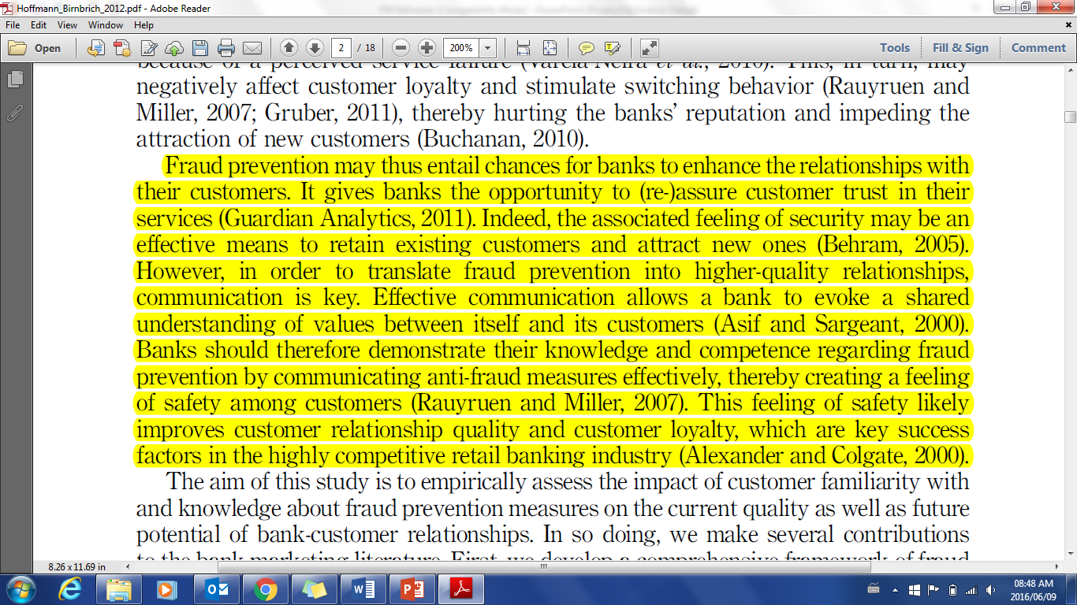
Referencing

Slide 31
“Fraud prevention may thus entail chances for banks to enhance the relationships with their customers. It gives banks the opportunity to (re-)assure customer trust in their services (Guardian Analytics, 2011)” (Hoffman & Birnbrich 2012:391).
Visible fraud prevention strategies have proven to be an effective way to increase customer confidence in a bank (Hoffman and Birnbrich 2012).
According to Hoffman and Birnbrich (2012) visible fraud prevention strategies have proven to be an effective way to increase customer confidence in a bank.

Slide 32
Hoffman, A.O.I. & Birnbrich, C., 2012 ‘The impact of fraud prevention on bank-customer relationships: An empirical investigation in retail banking’, International Journal of Bank Marketing, 30(5), 390-407

Slide 33
Activity
Are parachutes an effective intervention?
Paraphrase the provided article and discuss the merits of prescribing a single scientific testing method across the board

Slide 34
Nare@davinci.ac.za

